Slide 1


K.RAMAKRISHNAN COLLEGE OF TECHNOLOGY
(AUTONOMOUS), TRICHY
WEATHER FORCASTING PROJECT
PRESENTED BY
811721104023 – CHRISTINA EMY G
Guided by
V.Kalpana ,B.E., M.E.,
ASSISTANT PROFESSOR/CSE

Slide 2
PRESENTATION OVERVIEW
Objectives
Problem Statement
Existing System
Proposed System
Workflow
Architecture
Modules
Conclusion

Slide 3
OBJECTIVE
To accurately predict weather conditions like temperature, humidity, wind speed, and rainfall.
To help users plan daily activities and emergency responses based on weather conditions.
To improve the accuracy of weather forecasts using historical and real-time data.
To create a user-friendly system that displays weather predictions visually.

Slide 4
PROBLEM STATEMENT
Traditional weather forecasting systems often rely on manual data interpretation and may lack accuracy or user-friendliness.
These systems might not be responsive to changing weather patterns or capable of predicting localized
Events like sudden storms or heavy rain, affecting agriculture, transport, and daily life.

Slide 5
EXISTING SYSTEM
IRelies heavily on satellite and sensor-based data collected by meteorological departments.
Most systems show limited local predictions.
Accuracy decreases for long-term forecasting.
Lack of interactive and modern interfaces for end-users.
Limited use of machine learning for pattern recognition.

Slide 6
PROPOSED SYSTEM
A modern forecasting system using machine learning algorithms to analyze historical and real-time data.
Integration with APIs (like OpenWeatherMap) for real-time weather updates.
A user-friendly web or mobile interface to display forecasts, alerts, and recommendations.
Support for localized weather predictions.
Scalability for multiple regions and data sources.

Slide 7
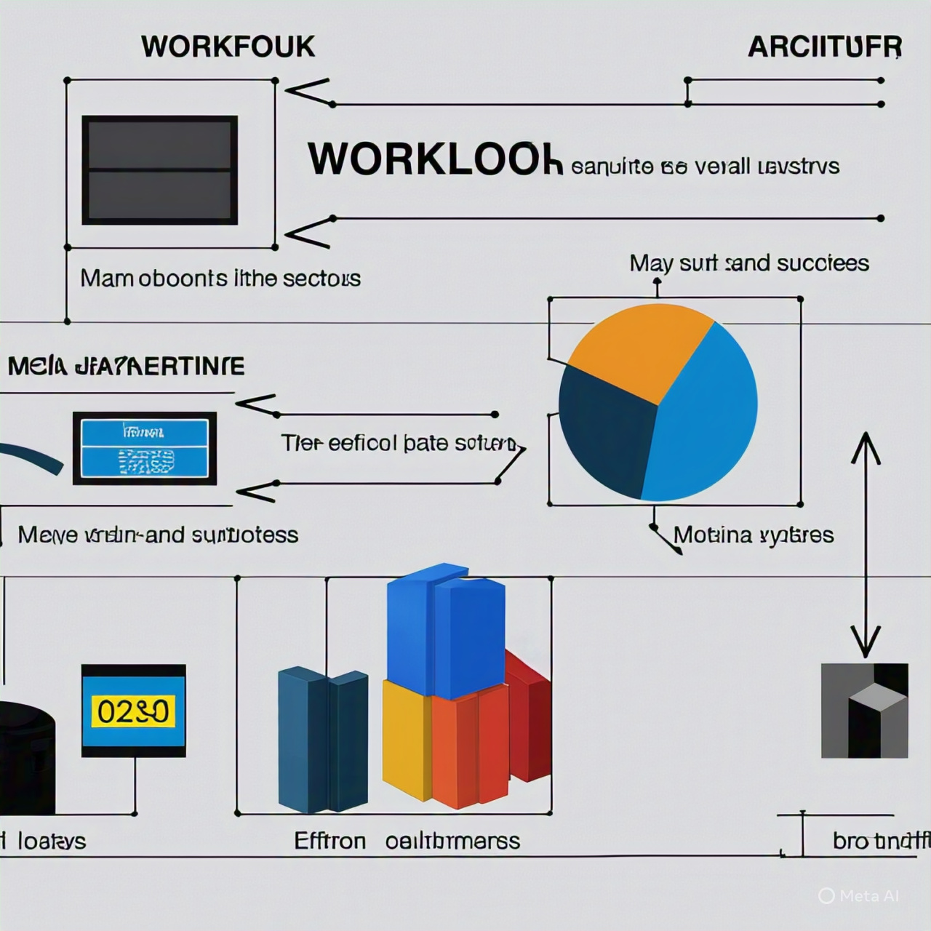

Slide 8
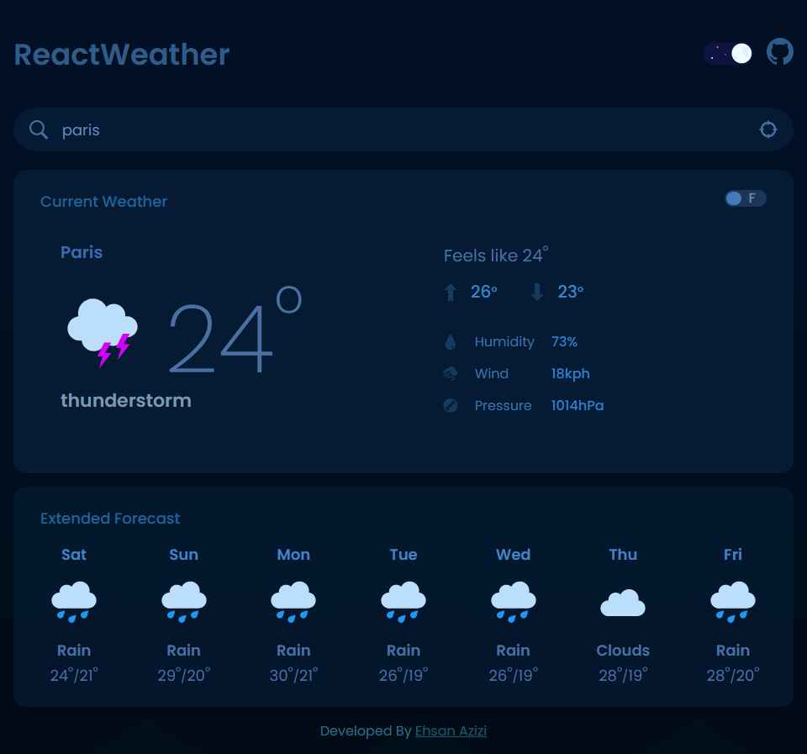
HOME PAGE

Slide 9
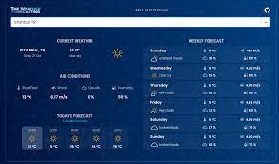
WEATHER INFORMATION

Slide 10
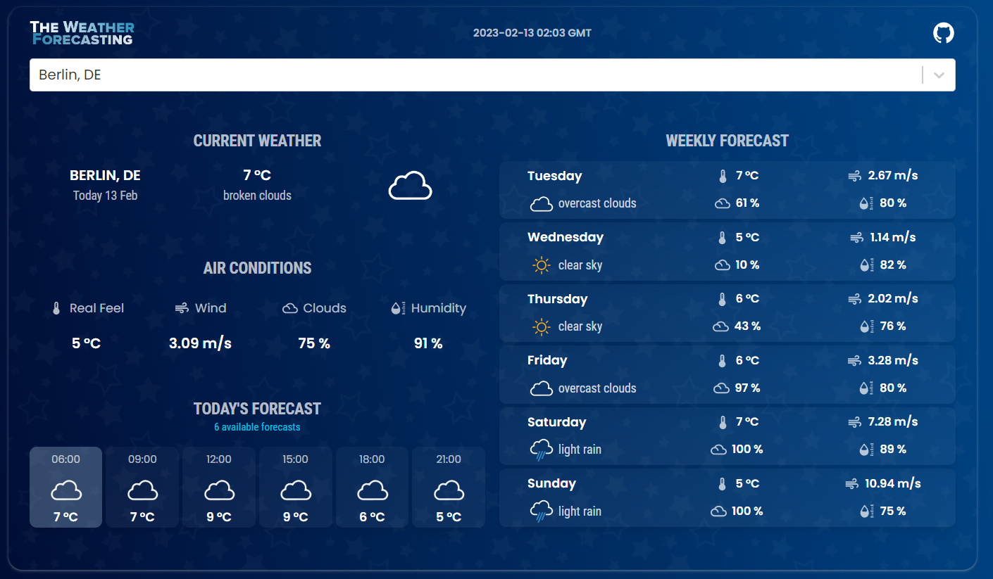
WEATHER INFORMATION

Slide 11
CONCLUSION
The proposed weather forecasting system offers a smarter, more accurate alternative to traditional models by integrating real-time data and machine learning.
It provides timely forecasts and alerts, helping users make informed decisions in agriculture, travel, and daily life. The system's modularity and scalability make it adaptable to future needs and technologies.

Slide 12
THANK YOU

